Slide 1
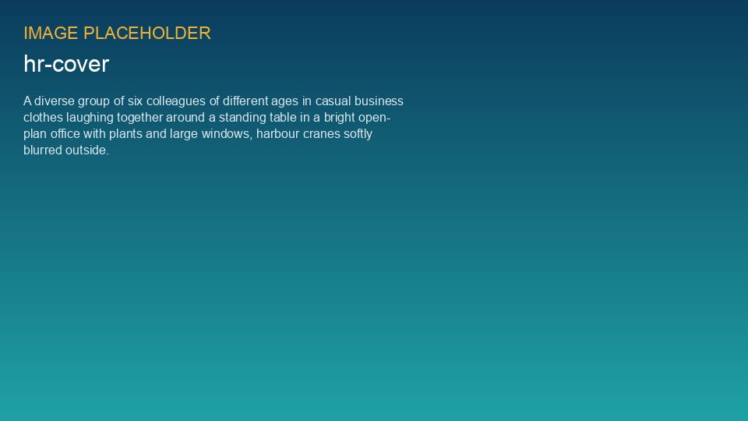
WEYLAND ENERGY
Engagement Survey 2026
Results for the leadership team · July 2026

Slide 2
Participation and headline scores
81 %
73
+24
88 %
response rate (358 of 442)
engagement index (+2)
eNPS (2025: +19)
feel safe to stop work
WEYLAND ENERGY · Engagement Survey 2026 – Results
2
Notes:
Survey ran 1–19 June 2026, anonymous, results only for groups of 7+ people.

Slide 3
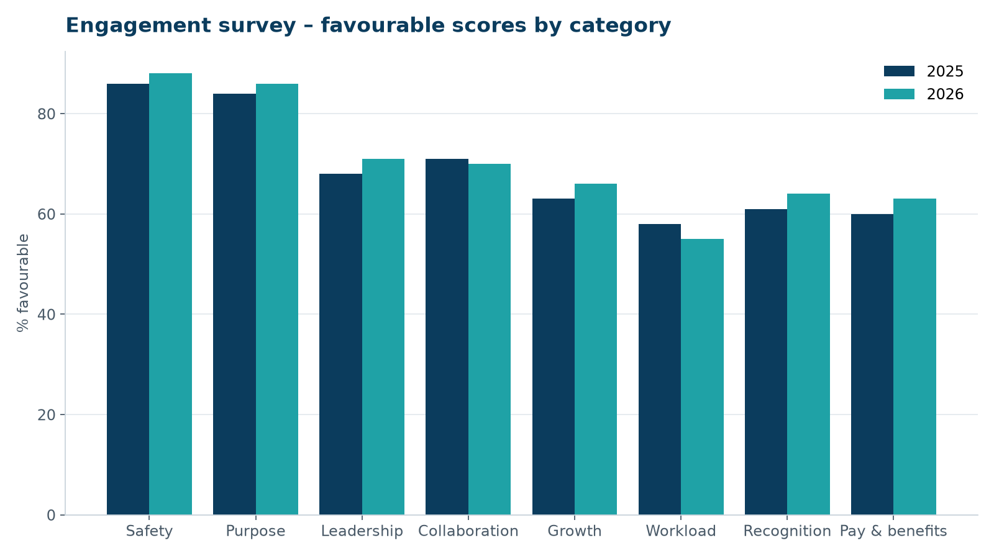
Scores by category
WEYLAND ENERGY · Engagement Survey 2026 – Results
3

Slide 4
What people value most
• Purpose: 86 % are proud of what Weyland does
• Safety culture is strong – especially offshore and at Kestrel Ridge
• Colleagues: 'people help each other across offices'
WEYLAND ENERGY · Engagement Survey 2026 – Results
4

Slide 5
Where we need to improve
• Workload (55 %, −3): Harrow Bay team and Legal under pressure
• Growth: unclear career paths for technicians and engineers
• Collaboration between Hamburg and Edinburgh on project decisions
WEYLAND ENERGY · Engagement Survey 2026 – Results
5
Notes:
Workload comments mention the cable delay and weekend work during monopile campaign.

Slide 6
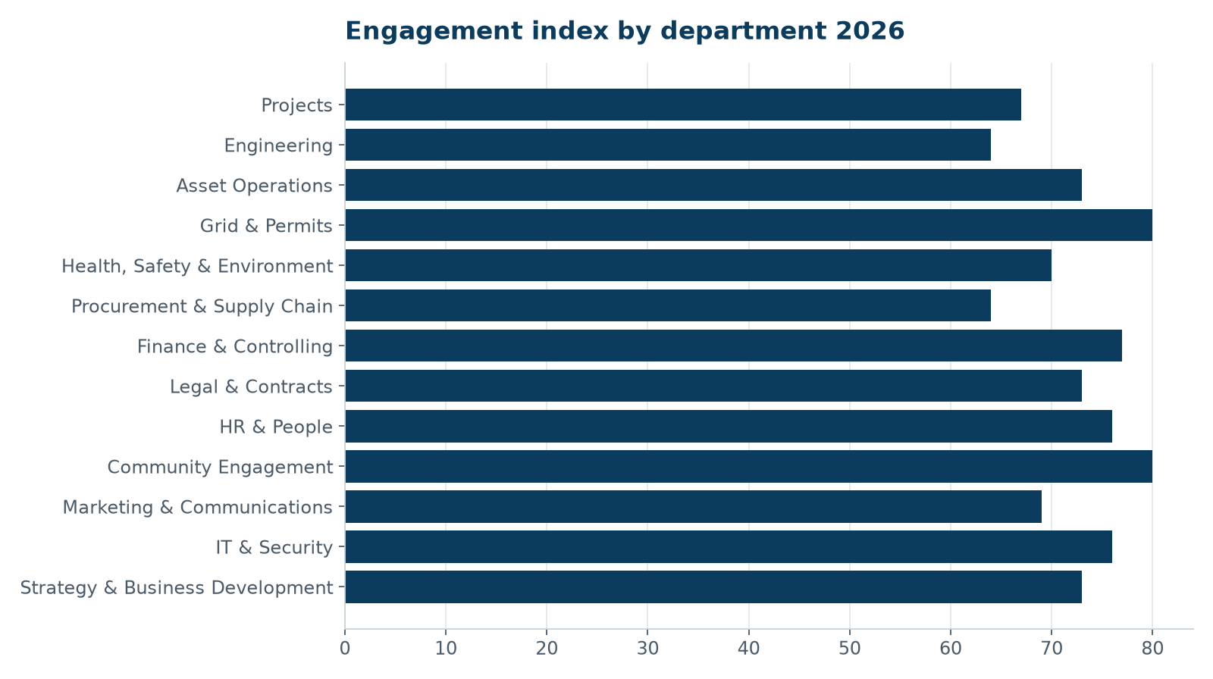
Engagement index by department
Company target 2026: 72
WEYLAND ENERGY · Engagement Survey 2026 – Results
6

Slide 7
“I know why my work matters – I just wish I had one meeting less per day.”
— Engineer, Copenhagen
WEYLAND ENERGY · Engagement Survey 2026 – Results
7

Slide 8
Proposed company-wide actions
Action | Owner | Due
Technician career path (T1–T4) incl. pay steps | Julia Hoffmann / David Chen | Dec 2026
Meeting-free Friday mornings | Executive Board | from Sep 2026
Harrow Bay resourcing review (+4 FTE) | Elena Márquez | Oct 2026
Cross-office project days twice a year | Julia Hoffmann | Nov 2026
WEYLAND ENERGY · Engagement Survey 2026 – Results
8

Slide 9
Next steps
• Department results to all managers by 15 July
• Team workshops until 30 September
• Action plans in the HR space by 30 November
• Pulse check in January 2027
WEYLAND ENERGY · Engagement Survey 2026 – Results
9

Slide 10
WEYLAND ENERGY
Thank you
Questions: Julia Hoffmann, HR Business Partner

